Slide 1
Junior Solar Sprints 2019
Progress Journal Template 2019
Car Name: Insert Here
School Name: Insert Here
[CAR PHOTO]
*This is just a GUIDE
Make it your OWN!
[Finished Model]

Slide 2
How to Use This Journal
Record keeping during the design process is an important part of Junior Solar Sprints. This document is here to help guide you through important investigations and topics that will help your team understand the science behind your model solar car.
Red text indicates something for you to do or answer. Replace this text with your own words!
Blue text indicates a hyperlink when viewing in “presentation mode.”
This is designed as a GUIDE. Slides that can be deleted will be denoted by the heading of the page being colored GREEN [as above]. PLEASE personalize and add additional related slides so that the reviewer can get a sense of the work that you have done!
See next slide for scoring rubric.
To edit this document go to “File,” “Save As” and save file to your own Google Drive or computer hard drive. Feeling stuck?
Email me with any questions or concerns at: ncharron@gohunterdon.org

Slide 3
Progress Journal Scoring Rubric | Poor (0 -1) | Satisfactory (2-3) | Good (3-4) | Excellent (4-5)
CONTENT is interesting, original, striking and substantial. | No changes made to the template provided, blank slides, content missing. | Team completed provided slides. | Team changed template entirely (or almost) to reflect a theme or personality while retaining legibility and coherence | Team changed template entirely. They utilized an innovative approach to displaying their information and maintained concepts from the original template
ORGANIZATION is well structured and exhibits chronological order, spatial order, comparison/contrast, etc.. | No apparent organization. | Team followed provided organization in template and presented their information coherently. | Team changed some of the provided organizational structure to fit their theme/personality and presented their information coherently. | Team changed the provided organizational structure entirely. Their unique organization resulted in information presented clearly and interestingly.
EXPERIMENTS, TESTING, CHANGES TO DESIGN, SCHEMATIC are organized, reasonable and coherent. Each supporting paragraph/description has a controlling idea, that is explored and results that are explained | No experiments were explored. No results were shown. No testing was explored. No design changes explored or explained. No schematic, drawing or image was presented. | Team completed at least 1 experiment from each Investigation category (Solar Power & Gears). Team provided at least 1 result for each experiment performed. Team completed some of the Materials chart. Team provided at least 1 design change. Team provided at least one schematic, drawing or image. | Team completed 2-3 experiments per Investigation category (Solar Power & Gears). Team provided results for each experiment listed. Team completed all of the Materials chart. Team provided at least 1 design change with explanation. Team provided multiple schematics, drawings or images. | Team completed 2-3 experiments per Investigation category (Solar Power & Gears) as well as additional experiments in categories not provided in template (Ex: Aerodynamics). Team completed all of the Materials chart. Team presented several design changes with explanations and provided multiple schematics, drawings or images.
GRAMMAR, SPELLING grammar, spelling, and mechanics | Contained mostly errors. No attempt at editing work made. | Contained some spelling, grammar or mechanics errors on no more than 50% of the total submitted work. | Contained few spelling, grammar or mechanics errors across total submitted work. | Contained no, or very minor spelling, grammar or mechanics errors across total submitted work.

Slide 4
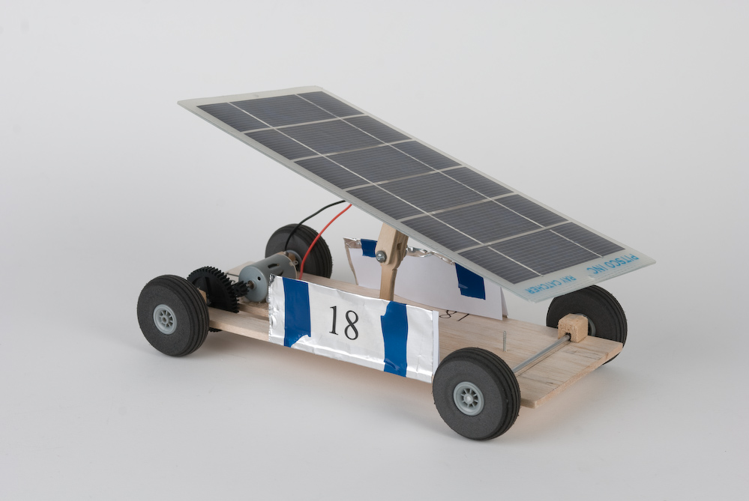
Investigation: Solar Power
Solar power is light and heat radiation from the sun converted into electrical power.
Sunlight contains tiny particles of energy called protons.
When sun rays hit the solar panel, the panel absorbs light and heat from the sun, forming an electrical current.
Electrical current is transferred by leads to power the motor.
Motor powers the driving gear.
While gears rotate they cause the axle and car’s wheels to spin, ultimately moving the car forward.
Leads connect electrical current to motor
Light and heat from sun
Gears, rear wheels and axle

Slide 5
Solar Angle Matters Workshop
Solar Panel Tilt | Multi-meter Reading
Facing the Sun
Lying flat
10⁰ (Small tilt)
45⁰ (Medium Tilt)
Directly Facing
Away from the Sun
10⁰ (Small tilt)
45⁰ (medium tilt)
Directly Away
Student Choice (Remember to write down the direction and the tilt you are taking a measurement for)

Slide 6
Investigation: Solar Power
Hypothesize on how your solar panel may work or not work.
Use the formula “if____________, then____________because________________.”
Example:
1 | If my solar panel is inside it will not generate electricity because solar cells do not respond to incandescent lighting.
What are TWO other hypotheses you could make about how your solar panel works?

Slide 7
Investigation: Solar Panels
Choose one of your hypotheses and design an experiment that will determine if your hypothesis is correct.
Example [from previous slide]:
What we are testing: If electricity is generated by a solar panel when it’s under incandescent light.
How we are testing: Hook the solar panel up to a small motor with a wheel attached. While under incandescent light, see if the solar panel will generate electricity to cause the wheel that is attached to the motor to spin.
*This slide can be deleted once you create your own!*

Slide 8
Investigation: Solar Panels
Hypothesis: Input here
How are you testing: Input here
Results: Input here
[Photos]

Slide 9
Investigation: Gear Ratio
Gear Ratio explains the rate at which two meshing gears spin. Gear ratio can be used to calculate the speed of two meshed gears. It is expressed in a fraction or ratio format (ex: ½ or 1:2).
Electric energy produced by the solar panel causes your car’s motor to spin.
Motor powers the driving gear.
Driver gear meshes with the follower gear. The follower is the gear placed on your axle.
While gears rotate they cause the axle and car’s wheels to spin, ultimately moving the car forward.

Slide 10
Investigation: Gear Ratio
To determine the size of each gear, count the “teeth” around the outside. When representing in a ratio the driver gear is always written first, so in the example below we write 8:16 instead of 16:8.
Driver- gear on the motor.
Follower- gear on the axle
8 tooth gear
16 tooth gear
How does gear ratio effect your car?
In the example above the gear ratio is 8:16, which we can also write as ½. This tells us that for every one complete turn the driver makes, the follower will only turn half way around. Cars with a gear ratio similar to ½ are likely to have more speed than torque (power). Experiment with the gears in your kit to find the best gear combination for your design!

Slide 11
Gear Ratios 101 Workshop
Gear # | Gear Ratio |  |  | Torque or Speed
 | A (Driver) | : | B (Driven)
1 |  | :
2 |  | :
3 |  | :
4 |  | :
5 |  | :
6 |  | :
7 |  | :

Slide 12
Gear Ratios 101 Workshop (cont.)
Use the steps you learned from the presentation to figure out what size wheel would work best for the gear ratio presented:
Known information for ALL problems:
Motor Speed, $ω:$ 5,200 revolutions per minute (rpm)
Vehicle Speed, V: Finishing times average ~6.5 seconds
Track Distance: 2,000 cm
$$V=\frac{2,000 cm}{6.5 s}=308 cm/s$$
Driver Gear: 10
Driven Gear: 60
Driver Gear: 40
Driven Gear: 20

Slide 13
Investigation: Gear Ratio
Fill in the chart. Use the gears in your kit to help you visualize each scenario below:
Driver Gear (size determined by counting the number of teeth around the gear’s edge) | Follower Gear (size determined by counting the number of teeth around the gear’s edge) | Gear Ratio (represent as a fraction or ratio) | If the driver turns once, how many times will the follower turn?
20 | 40
10 | 50
60 | 30

Slide 14
Investigation: Gear Ratio
Hypothesize on how gears matter to your model car construction.
Use the formula “if____________, then____________becasuse________________.”
Example:
₁ | If my model car’s gears don’t fit together my car won’t move because it’s the connection of gears that transfers motion/energy to move my car.
What are TWO other hypotheses you could make about how gear ratios will impact your car?

Slide 15
Investigation: Gear Ratio
Choose one of your hypotheses to test. Design an experiment that will help decide if your hypothesis is correct.
Example [from previous slide]:
What we are testing: If my car’s gears don’t fit together it won’t move because there will be no connection of energy
How we are testing: Set up one car with meshing gears and one car without. See which car moves.
*This slide can be deleted once you create your own!*

Slide 16
Investigation: Gear Ratio
Hypothesis: Input here
How are you testing: Input here
Results: Input here
[Photos]

Slide 17
Investigation: Materials
Record the different materials you tried while designing your car in the chart below:
Part of Car | Material | Durable? (yes/no) | Was this piece recycled? (yes/no) | Can this piece be salvaged and reused? (yes/no) | Does this piece come from a renewable resource? (yes/no) | What is the weight of this piece? (in grams)
Chassis
Motor mount
Wheels
Axles
Race line attachment
Soda can compartment

Slide 18
Strength of Shapes
Build Process Workshop
Name
Name
Name
Name
After building all of these shapes, which one do you think is the strongest?
Shape

Slide 19
Design Schematic
A Design schematic is a plan, drawing or diagram to help illustrate and convey the concept/ideas of your design.
[Schematic]
Feel free to delete everything else on this page to make your schematic fit

Slide 20
Aerodynamics Workshop
Trial Number | Time (s) | Fan Setting
Trial #1
Trial #2
Trial #3
Average

Slide 21
Prototypes and Testing
Explain any issues or problems you had to deal with when testing your car. Also discuss solutions to those problems. Include pictures or videos when possible.
Prototype | Did it work on battery power? (yes/no) | Did it work on solar power? (yes/no) | If it did not work on solar, how did you try to fix/improve your design?
1
2
3

Slide 22
Prototypes and Testing
Hypothesis: Input here
How are you testing: Input here
Results: Input here
[Photos]

Slide 23
At The Race Line Workshop
Hypothesis: Input here
How are you testing: Input here
Results: Input here
[Photos]

Slide 24
Time Trials
Test your car and make modifications based on your results.
Use the chart below to help record your data and draw conclusions from each trial.
Trial # | Distance (cm) | Time (s) | Speed (cm/s)
1
2
3

Slide 25
Finished!
*Remember you can change anything you want about this document, style, fonts, colors, backgrounds, etc., just ensure all the required material (scored material) is included.

