Slide 1
Hunterdon County Junior Solar Sprints 2020
Progress Journal Template 2020
CAR NAME
SCHOOL NAME
CAR PHOTO
[Finished]
*Adding photos of your group doing work, in each section, on your project can help to better explain what you did and why you did it*

Slide 2
Using your Journal
Step 1: Save this journal to your computer and make sure everyone in your group has access to it.
Step 2: Look through the journal and assign documentation tasks to your group members. Boxes are included in the lower left corners of pages requiring information to be added to assign pages [if needed].
Step 3: Do your part! After a lesson, workshop, or just a day working on your car be sure to input what you learned/did as quickly as you can to ensure that you remember everything and capture what you did
Step 4: EVERYTHING about this journal can be changed and altered so feel free to make it your own!
Red Text indicates a question that should be replaced with your answer. Be sure to use complete sentences!
Blue text indicates a hyperlink that can be followed for additional information
Questions or concerns about your journal? Email jbettermann@gohunterdon.org

Slide 3
Progress Journal Scoring Rubric | Poor (0 -1) | Satisfactory (2-3) | Good (3-4) | Excellent (4-5)
CONTENT is interesting, original, striking and substantial. | No changes made to the template provided, blank slides, content missing. | Team completed provided slides. | Team changed template entirely (or almost) to reflect a theme or personality while retaining legibility and coherence | Team changed template entirely. They utilized an innovative approach to displaying their information and maintained concepts from the original template
ORGANIZATION is well structured and exhibits chronological order, spatial order, comparison/contrast, etc.. | No apparent organization. | Team followed provided organization in template and presented their information coherently. | Team changed some of the provided organizational structure to fit their theme/personality and presented their information coherently. | Team changed the provided organizational structure entirely. Their unique organization resulted in information presented clearly and interestingly.
EXPERIMENTS, TESTING, CHANGES TO DESIGN, SCHEMATIC are organized, reasonable and coherent. Each supporting paragraph/description has a controlling idea, that is explored and results that are explained | No experiments were explored. No results were shown. No testing was explored. No design changes explored or explained. No schematic, drawing or image was presented. | Team completed at least 1 experiment from each Investigation category (Solar Power & Gears). Team provided at least 1 result for each experiment performed. Team completed some of the Materials chart. Team provided at least 1 design change. Team provided at least one schematic, drawing or image. | Team completed 2-3 experiments per Investigation category (Solar Power & Gears). Team provided results for each experiment listed. Team completed all of the Materials chart. Team provided at least 1 design change with explanation. Team provided multiple schematics, drawings or images. | Team completed 2-3 experiments per Investigation category (Solar Power & Gears) as well as additional experiments in categories not provided in template (Ex: Aerodynamics). Team completed all of the Materials chart. Team presented several design changes with explanations and provided multiple schematics, drawings or images.
GRAMMAR, SPELLING grammar, spelling, and mechanics | Contained mostly errors. No attempt at editing work made. | Contained some spelling, grammar or mechanics errors on no more than 50% of the total submitted work. | Contained few spelling, grammar or mechanics errors across total submitted work. | Contained no, or very minor spelling, grammar or mechanics errors across total submitted work.

Slide 4
Group Names and Roles
[On this slide, include the names of everyone in your group and what they will be contributing to the groups work in the Junior Solar Sprints program.]

Slide 5
Build Process Workshop
Name
Name
Name
Name
After building all of these shapes, which one do you think is the strongest?
Assigned to:

Slide 6
Design Schematic
A Design schematic is a plan, drawing or diagram to help illustrate and convey the concept/ideas of your design.
SCHEMATIC
Assigned to:

Slide 7
Materials
Input all of the materials that you are using and/or thinking about using for your vehicle.
Chassis
[Answer the following information for each part of your vehicle]
Material
Durable?
Recycled/Recycleable?
Weight [grams]
2. Motor Mounting
3. Wheels
4. Axles
5. Race Line Attachment
6. Passenger Compartment
Assigned to:

Slide 8
Hypothesis
Develop a hypothesis that you can test on your own to help you choose your supplies for your vehicle.
[Remember that a hypothesis is an educated guess using if, then, and because statements.]
Testing
Develop a way to test your hypothesis to see if it is correct or incorrect.
Results
What did you learn by performing the test? Was your hypothesis correct or incorrect? How does this information impact your design for your solar car?
Assigned to:

Slide 9
Investigation: Gear Ratio
[This slide is for some background on the topic. Feel free to delete it once you are finished reviewing the information.]
Gear Ratio explains the rate at which two meshing gears spin. Gear ratio can be used to calculate the speed of two meshed gears. It is expressed in a fraction or ratio format (ex: ½ or 1:2).
Electric energy produced by the solar panel causes your car’s motor to spin.
Motor powers the driving gear.
Driver gear meshes with the follower gear. The follower is the gear placed on your axle.
While gears rotate they cause the axle and car’s wheels to spin, ultimately moving the car forward.

Slide 10
Investigation: Gear Ratio
[This slide is for some background on the topic. Feel free to delete it once you are finished reviewing the information.]
To determine the size of each gear, count the “teeth” around the outside. When representing in a ratio the driver gear is always written first, so in the example below we write 8:16 instead of 16:8.
Driver- gear on the motor.
Follower- gear on the axle
8 tooth gear
16 tooth gear
How does gear ratio effect your car?
In the example above the gear ratio is 8:16, which we can also write as ½. This tells us that for every one complete turn the driver makes, the follower will only turn half way around. Cars with a gear ratio similar to ½ are likely to have more speed than torque (power). Experiment with the gears in your kit to find the best gear combination for your design!

Slide 11
Gear Ratios 101 Workshop
Gear # | Gear Ratio |  |  | Torque or Speed
 | A (Driver) | : | B (Driven)
1 |  | :
2 |  | :
3 |  | :
4 |  | :
5 |  | :
6 |  | :
7 |  | :

Slide 12
Hypothesis
Develop a hypothesis that you can test on your own to better understand how gears work
[Remember that a hypothesis is an educated guess using if, then, and because statements.]
Testing
Develop a way to test your hypothesis to see if it is correct or incorrect.
Results
What did you learn by performing the test? Was your hypothesis correct or incorrect? How does this information impact your design for your solar car?
Assigned to:

Slide 13
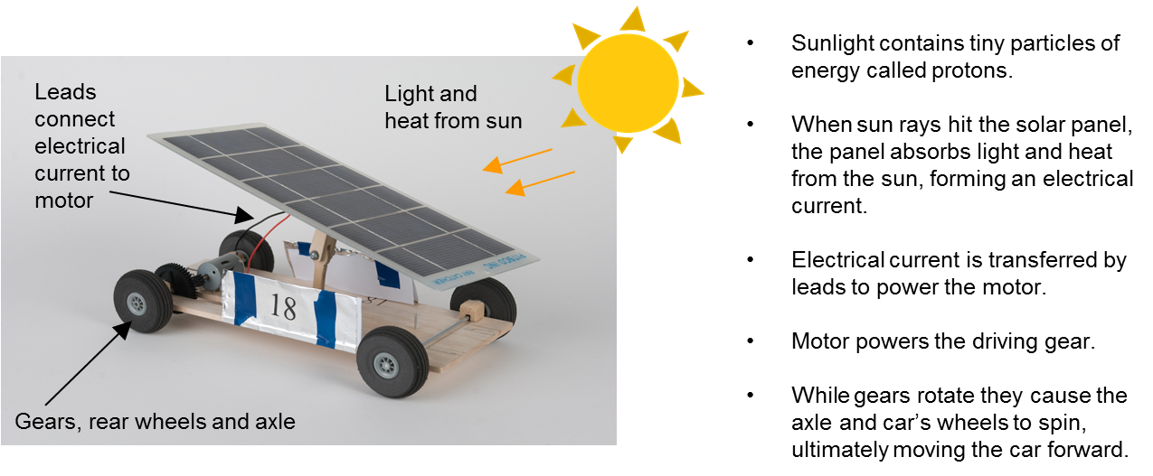
Investigation: Solar Power
[This slide is for some background on the topic. Feel free to delete it once you are finished reviewing the information.]

Slide 14
Understanding the Solar Workshop
Below answer the questions about solar energy:
How were you able to take a reading of the sun’s energy?
What position was the solar panel in that provided you with the MOST energy? LEAST energy?
How did you adapt your knowledge from the initial tests to maximize the energy generated for the final “Student Choice” measurements?
What was the highest amount of solar energy you were able to generate? What was the lowest amount of energy you were able to generate?
Assigned to:

Slide 15
Hypothesis
Develop a hypothesis that you can test on your own to better understand how your solar panel works
[Remember that a hypothesis is an educated guess using if, then, and because statements.]
Testing
Develop a way to test your hypothesis to see if it is correct or incorrect.
Results
What did you learn by performing the test? Was your hypothesis correct or incorrect? How does this information impact your design for your solar car?
Assigned to:

Slide 16
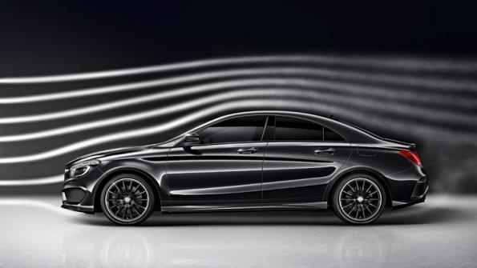
Investigation: Aerodynamics
[This slide is for some background on the topic. Feel free to delete it once you are finished reviewing the information.]
Aerodynamics is the study of the interaction between the air and an object moving through it.
Drag – is the force that pushes the car backwards. Minimizing drag is important in consistent speed of your vehicle while moving.
Different shapes interact with the air differently as the move through it.

Slide 17
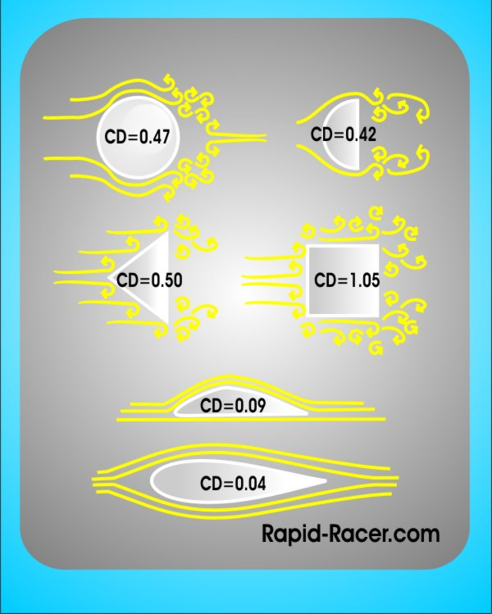
Investigation: Aerodynamics
[This slide is for some background on the topic. Feel free to delete it once you are finished reviewing the information.]
Things to think about
How is the shape of my car impacting the way it travels through the air?
What is happening to an object, such as the square, that has a flat front?
What is happening to an abject, such as a triangle, that has a drop off at the back of the shape?
What is happening with the tear drop shaped object? What force is being created by that shape?

Slide 18
Hypothesis
Develop a hypothesis that you can test on your own to better understand how your car interacts with the air as it moves through it.
[Remember that a hypothesis is an educated guess using if, then, and because statements.]
Testing
Develop a way to test your hypothesis to see if it is correct or incorrect.
Results
What did you learn by performing the test? Was your hypothesis correct or incorrect? How does this information impact your design for your solar car?
Assigned to:

Slide 19
Investigation: Race Line
[This slide is for some background on the topic. Feel free to delete it once you are finished reviewing the information.]
Some things to remember about the race line:
The race line is made from 60# monofilament fishing line
The race line is approximately ½ inch (1.5 cm) above the track
The race line is attached at both ends of the track and CANNOT be undone
The race line is pulled tight to allow the car to travel along it
Your car must stay on the line all the way down the track, if it comes off of the line this is considered a loss for your vehicle.
The diagram on the next slide shows how the race line is set up on race day.

Slide 20
Track
Wood Block
Race Line
Weight
1
1
Start Line
Finish Line
2
2
3
Lane #
3
Race Line spans the entire racing area
It is connected on both sides by being tied to eyehooks
The Race line cannot be undone
You must find a way to easily attach and un-attach your car from the Race Line
Eyehook

Slide 21
Hypothesis
Develop a hypothesis that you can test on your own to better understand how you will attach your vehicle to the race line.
[Remember that a hypothesis is an educated guess using if, then, and because statements.]
Testing
Develop a way to test your hypothesis to see if it is correct or incorrect.
Results
What did you learn by performing the test? Was your hypothesis correct or incorrect? How does this information impact your design for your solar car?
Assigned to:

Slide 22
Prototypes and Testing
Building a prototype is a great way to test out different functions of your car before you put them on your final version.
Include the following information for each prototype or version of your vehicle prior to your final:
Prototype # and/or Name
Additions/subtractions from previous versions
Did it work on battery? Yes/No?
Did it work on solar? Yes/No?
Why do you think it did or did not work?
What changes do you plan to make in your design?
Add pictures as needed to describe your building, testing, and redevelopment process.
Assigned to:

Slide 23
Testing, Evaluation,
& Redevelopment
Use additional slides to document the following:
Tests performed with your vehicle
Changes made to your vehicle and why they were done
Photographs of your work
The chart below is helpful in recording data from testing, drawing conclusions and developing changes to your vehicle.
Trial # | Distance (cm) | Time (s) | Speed (cm/s)
1
2
3

Slide 24
Finished!
*Remember to double check your slides for errors and double check the scoring rubric to make sure you have included all the information that will be scored. You can change anything about this document. Make sure it tells your story!*
[Delete this slide when finished!]

